Slide 1

Systems Analysis and Design
Chapter 1: Foundation of system development
Slides in this presentation contain hyperlinks. JAWS users should be able to get a list of links by using INSERT+F7
Notes:
If this PowerPoint presentation contains mathematical equations, you may need to check that your computer has the following installed:
1) MathType Plugin
2) Math Player (free versions available)
3) NVDA Reader (free versions available)

Slide 2
Learning Objectives
1.1 Define information systems analysis and design
1.2 Describe the information systems development life cycle (S D L C)
1.3 Describe the agile methodologies, eXtreme Programming, and Scrum
1.4 Explain object-oriented analysis and design and the Rational Unified Process (R U P)

Slide 3
Introduction
Information Systems Analysis and Design
Defined as the complex, challenging, and simulating organizational process that a team of business and systems professionals uses to develop and maintain information systems
Application Software
Software designed to support organizational function or process
Systems Analyst
Organizational role most responsible for analysis and design of information systems

Slide 4
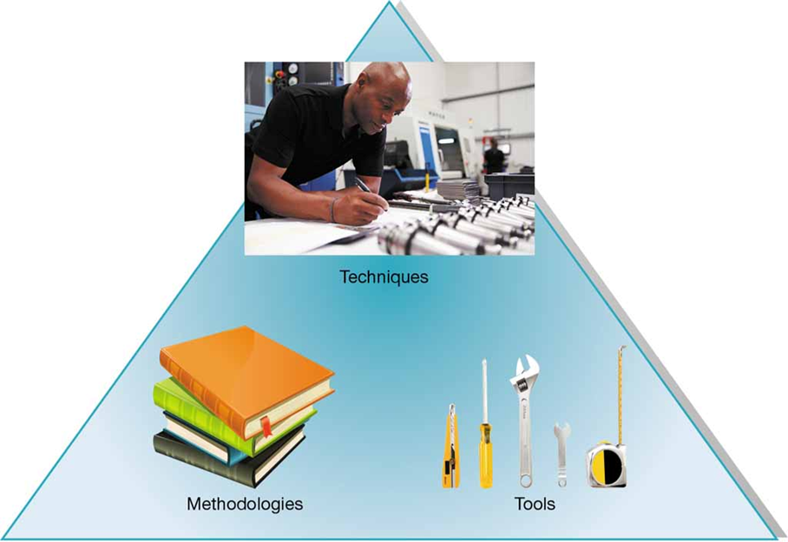
Figure 1-1: An Organizational Approach to Systems Analysis and Design Is Driven by Methodologies, Techniques, and Tools
(Sources: Top: Monkey Business Images/Shutterstock; Left: benchart/Shutterstock; Right: Lifestyle Graphic/Shutterstock)

Slide 5
A Modern Approach to Systems Analysis and Design (1 of 3)
1.1 Define information systems analysis and design
1950s
Goal was efficiency of processing
Emphasis was on automating existing processes
All applications developed in machine or assembly language
1960s
Advent of procedural (third-generation) languages
Enabled development of smaller, faster, less expensive computers
1970s
System development came to be more disciplined
Became more like engineering as focus shifted from process first to data first

Slide 6
A Modern Approach to Systems Analysis and Design (2 of 3)
1.1 Define information systems analysis and design
1980s
Marked by major breakthroughs in organizations as microcomputers became key organizational tools
Software industry expanded writing off-the-shelf software
4G L development led to instructing computers what to do instead of how to do it
1990s
Focused on system integration
Developers used visual programming environments (Visual Basic)
Relational and object-oriented databases developed
Enterprise-wide systems developed
Web and Internet applications begun and expanded

Slide 7
A Modern Approach to Systems Analysis and Design (3 of 3)
1.1 Define information systems analysis and design
Present day
Continued focus on developing systems for the Internet and for firm’s intranets and extranets
Implementation involving three-tier design
Database on one server
Application on second server
Client logic located on user machines
Move to wireless system components (access from anywhere)
Continuing trend toward assembling systems from programs and components purchased off the shelf

Slide 8
Principles of System Development
1.1 Define information systems analysis and design
Get the system user involved
Use a problem-solving approach
Establish phases and activities
Document through development
Establish standards
Manage process and the projects
Justify systems as capital investments
Don’t be afraid to cancel or revise scope
Divide and conquer

Slide 9
Developing Information Systems and the Systems Development Life Cycle
1.2 Describe the information systems development life cycle (S D L C)
Systems development methodology
A standard process followed in an organization to conduct all the steps necessary to analyze, design, implement, and maintain information systems
The systems development life cycle (S D L C)
The traditional methodology used to develop, maintain, and replace information systems
Features several phases that mark the progress of the systems analysis and design efforts

Slide 10
Systems Development Life Cycle
Figure 1-2 Systems development life cycle
1.2 Describe the information systems development life cycle (S D L C)
A circular process, with the end of the useful life leading to the start of another
At any given phase the project can return to a previous phase when needed
Can be an iterative process

Slide 11
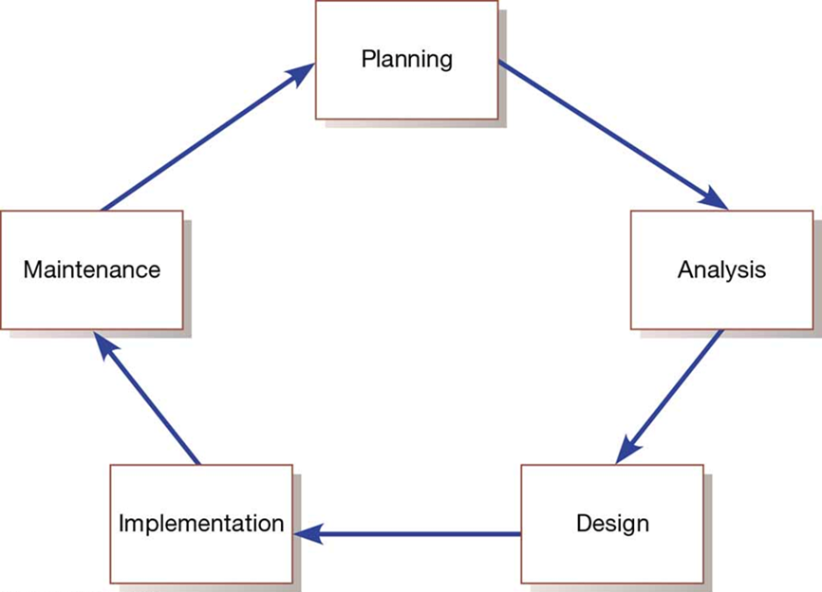
Figure 1-2: Systems Development Life Cycle

Slide 12
Evolutionary Model
1.2 Describe the information systems development life cycle (S D L C)
A spiral process in which one is constantly cycling through phases at different levels

Slide 13
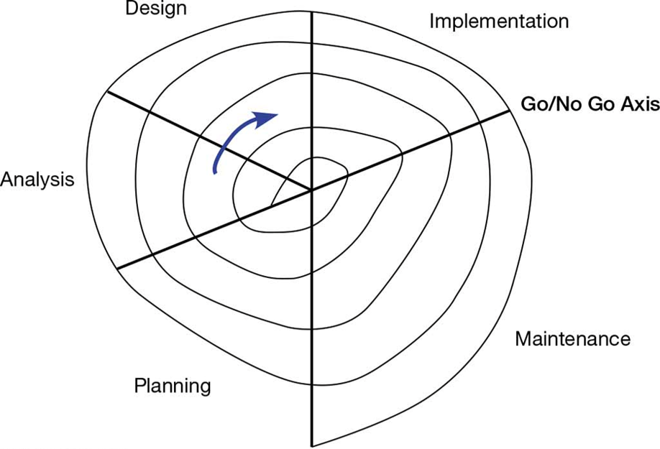
Figure 1-3: Evolutionary Model

Slide 14
Phases of the S D L C (1 of 3)
1.2 Describe the information systems development life cycle (S D L C)
Planning
Need for a new or enhanced system is identified
Needs are identified, analyzed, prioritized, and arranged
Determine the scope of the proposed system
Baseline project plan is developed
Analysis
System requirements are studied from user input and structured
Requires careful study of current systems, manual and computerized, that might be replaced or be enhanced
Output is description of the alternate solution recommend by the analysis team

Slide 15
Phases of the S D L C (2 of 3)
1.2 Describe the information systems development life cycle (S D L C)
Design
Analyst converts the alternate solution into logical and physical specifications
Logical Design
The design process part that is independent of any specific hardware or software platform
Physical Design
The logical specifications of the system from logical design are transformed into technology-specific details from which all programing/system construction can be accomplished
Choices of language, database, and platform are many times already decided by the organization or client

Slide 16
Phases of the S D L C (3 of 3)
1.2 Describe the information systems development life cycle (S D L C)
Implementation
Occurs when the information system is coded, tested, installed, and supported in the organization
New systems become part of the daily activities of the organization
Maintenance
The phase in which an information system is systematically repaired and improved
Organization’s needs may change over time requiring changes to the system based on user’s needs

Slide 17
Table 1-1: Products of SDLC Phases
1.2 Describe the information systems development life cycle (S D L C)
Phase | Products, Outputs, or Deliverables
Planning | Priorities for system and projects; an architecture for data, networks, and selection hardware, and information systems management are the result of associated systems Detailed steps, or work plan, for project Specification of system scope and planning and high-level system requirements or features Assignment of team members and other resources System justification or business case
Analysis | Description of current system and where problems or opportunities exist, with a general recommendation on how to fix, enhance, or replace current system Explanation of alternative systems and justification for chosen alternative
Design | Functional, detailed specifications of system elements (data, processes, inputs, and outputs) Technical, detailed specifications of all system elements (programs, files, network, system software, etc.) Acquisition plan for new technology
Implementation | Code, documentation, training procedures, and support capabilities
Maintenance | New versions or releases of software with associated updates to documentation, training, and support

Slide 18
Analysis-Design-Code-Test Loop
1.2 Describe the information systems development life cycle (S D L C)
The Analysis-Design-Code-Test Loop is an example of traditional practice

Slide 19
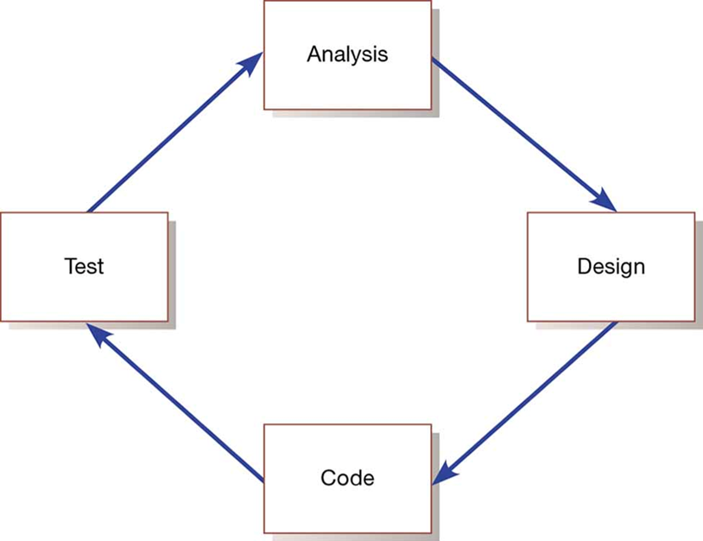
Figure 1-6: Analysis-Design-Code-Test Loop

Slide 20
Heart of Systems Development
1.2 Describe the information systems development life cycle (S D L C)
Current practice combines analysis, design, and implementation into a single process

Slide 21
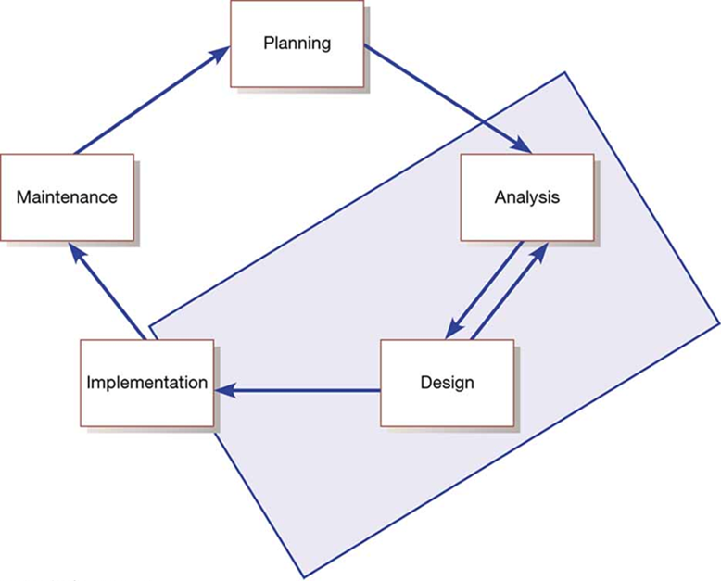
Figure 1-7: Heart of Systems Development

Slide 22
The S D L C Traditional Waterfall Problems
1.2 Describe the information systems development life cycle (S D L C)
Once one phase ends another begins, going downhill until complete
Makes it difficult to go back
Results in great expense to make changes
Role of system users or customers narrowly defined
Focused on deadlines

Slide 23
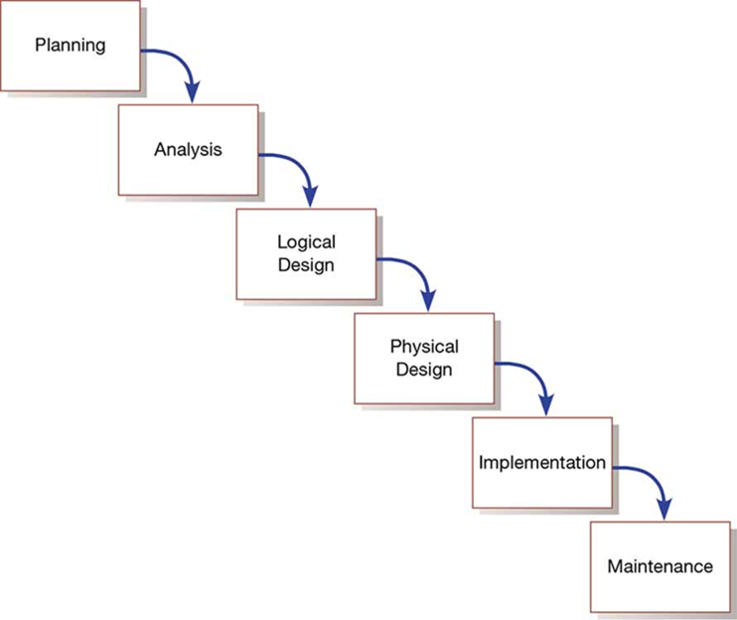
Figure 1-8: Traditional Waterfall S D L C

Slide 24
Agile Methodologies
1.3 Describe the agile methodologies, eXtreme Programming, and Scrum
Agile methodologies share three key principles:
A focus on adaptive rather than predictive methodologies
A focus on people rather than roles
A focus on self-adaptive processes

Slide 25
Table 1-2: The Agile Manifesto (1 of 3)
The agile methodologies group argues that software development methodologies adapted from engineering generally do not fit with real world software development
The Manifesto for Agile Software Development (Table 1-2)
Seventeen anarchists agree
We are uncovering better ways of developing software by doing it and helping others do it. Through this work we have come to value:
Individuals and interactions over processes and tools
Working software over comprehensive documentation
Customer collaboration over contract negotiation
Responding to change over following a plan

Slide 26
Table 1-2: The Agile Manifesto (2 of 3)
That is, while we value the items on the right, we value the items on the left more. We follow the following principles:
The highest priority is to satisfy the customer through early and continuous delivery of valuable software.
Welcome changing requirements, even late in development. Agile processes harness change for the customer’s competitive advantage.
Deliver working software frequently, from a couple of weeks to a couple of months, with a preference to the shorter timescale.
Businesspeople and developers work together daily throughout the project.
Build projects around motivated individuals. Give them the environment and support they need and trust them to get the job done.
The most efficient and effective method of conveying information to and within a development team is face-to-face conversation.
Working software is the primary measure of progress.

Slide 27
Table 1-2: The Agile Manifesto (3 of 3)
Continuous attention to technical excellence and good design enhances agility.
Agile processes promote sustainable development. The sponsors, developers, and users should be able to maintain a constant pace indefinitely.
Simplicity—the art of maximizing the amount of work not done—is essential.
The best architectures, requirements, and designs emerge from self-organizing teams.
At regular intervals, the team reflects on how to become more effective, then tunes and adjusts its behavior accordingly.
--Kent Beck, Mike Beedle, Are van Bennekum, Alistair Cockburn, Ward Cunningham, Martin Fowler, James Grenning, Jim Highsmith, Andrew Hunt, Ron Jefferies, Jon Kern, Brian Marick, Robert C. Martin, Steve Mellor, Ken Schwaber, Jeff Sutherland, Dave Thomas (www.AgileAlliance.org)

Slide 28
Agile Methodologies—Not for Every Project
1.3 Describe the agile methodologies, eXtreme Programming, and Scrum
Agile methodologies are not for everyone
Fowler recommends an agile process if your project involves
unpredictable or dynamic requirements
responsible and motivated developers
customers who understand the process and will get involved

Slide 29
Table 1-3: Five Critical Factors that Distinguish Agile and Traditional Approaches to System Development
1.3 Describe the agile methodologies, eXtreme Programming, and Scrum
Factor | Agile Methods | Traditional Methods
Size | Well matched to small products and teams Reliance on tacit knowledge limits scalability | Methods evolved to handle large products and teams Hard to tailor down to small products
Criticality | Untested on safety-critical products Potential difficulties with simple design and lack of documentation | Methods evolved to handle highly critical products Hard to tailor down to products that are not critical.
Dynamism | Simple design and continuous refactoring are excellent for highly dynamic environments but a source of potentially expensive rework for highly stable environments | Detailed plans and Big Design Up Front, excellent for highly stable environment but a source of expensive rework for highly dynamic environments
Personnel | Requires continuous presence of a critical mass of scarce experts Risky to use non-agile people | Needs a critical mass of scarce experts during project definition but can work with fewer later in the project, unless the environment is highly dynamic
Culture | Thrives in a culture where people feel comfortable and empowered by having many degrees of freedom (thriving on chaos) | Thrives in a culture where people feel comfortable and empowered by having their roles defined by clear practices and procedures (thriving on order)

Slide 30
eXtreme Programming (1 of 2)
1.3 Describe the agile methodologies, eXtreme Programming, and Scrum
Short, incremental development cycles
Focus on automated tests written by programmers
Emphasis on two-person programming teams
Customers to monitor the development process
Relevant parts of eXtreme Programming that relate to design specifications are
How planning, analysis, design, and construction are all fused into a single phase of activity
Its unique way of capturing and presenting system requirement and design specifications

Slide 31
eXtreme Programming (2 of 2)
1.3 Describe the agile methodologies, eXtreme Programming, and Scrum
Coding and testing are related parts of the same process
Advantages include
Increased communications among developers
Higher levels of productivity
Higher quality code
Reinforcement of other practices in eXtreme Programming
Include code-and-test discipline

Slide 32
Scrum (1 of 3)
1.3 Describe the agile methodologies, eXtreme Programming, and Scrum
Originated in 1995 by Sutherland and Schwaber
Most popular methodology for agile (58%)
Scrum framework includes
Scrum teams with associated roles, events, artifacts, and rules
Each team consists of three roles
Product owner
Development team
Scrum master

Slide 33
Scrum (2 of 3)
1.3 Describe the agile methodologies, eXtreme Programming, and Scrum
Scrum designed for speed and multiple functional product releases
Primary unit is the Sprint (runs two weeks to a month)
Starts with an eight-hour planning meeting
What needs to be delivered by the end of the sprint
How will the team accomplish that work
Daily Standup: A 15-minute meeting held to evaluate progress made within the past 24 hours and what needs to be done

Slide 34
Scrum (3 of 3)
1.3 Describe the agile methodologies, eXtreme Programming, and Scrum
At the end of the sprint, two additional meetings
The Sprint Review: (4 hours) focusing on the product, what has been accomplished, and what needs to be done
The Sprint Retrospective: (3 hours) focusing on team performance and how it can improve
Three primary artifacts in the Scrum process
Product Backlog: Listing of potential requirements
Sprint Backlog: Listing of only items to be addressed in a particular sprint
Increment: Represents the sum of all the Product Backlog items completed during a sprint.

Slide 35
Agile in Practice
1.3 Describe the agile methodologies, eXtreme Programming, and Scrum
Three primary factors critical for success
Delivery strategy: Continuous delivery of working software in short time scales
Following agile software engineering practices
Team capability: Agile principle of building projects around motivated individuals
Agile development offers managers and programmers more choice in their efforts to produce good systems that come in on time and under budget

Slide 36
Object-Oriented Analysis and Design (O O A D)
1.4 Explain object-oriented analysis and design and the Rational Unified Process (R U P)
Based on objects rather than data or processes
Combines data and processes (called methods) into single entities call objects
Object: A structure that encapsulates attributes and methods that operate on those attributes
Inheritance: Hierarchical arrangement of classes enabling subclasses to inherit properties of superclasses
Object Class: Logical grouping of objects that have the same attributes and behaviors

Slide 37
Rational Unified Process (R U P)
1.4 Explain object-oriented analysis and design and the Rational Unified Process (R U P)
Rational Unified Process (R U P) is an object-oriented systems development methodology
Based on an iterative, incremental approach to systems development
R U Ps four phases (each can be further divided)
Inception
Elaboration
Construction
Transition

Slide 38
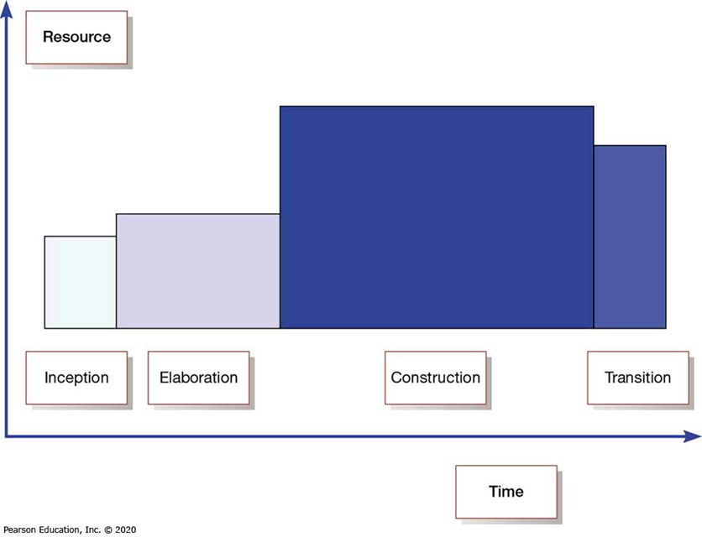
Figure 1-9: Phases of O O A D-Based Development

Slide 39
Our Approach to Systems Development
1.4 Explain object-oriented analysis and design and the Rational Unified Process (R U P)
Criticisms of the S D L C include
Forced timed phases on intangible and dynamic processes were doomed to fail
Life-cycle reliance has resulted in massive amounts of process and documentation
Cycles are not necessarily waterfalls

Slide 40
Summary
In this chapter you learned how to:
Define information systems analysis and design
Describe the information systems development life cycle (S D L C)
Describe Agile Methodologies, eXtreme Programming, and Scrum
Explain object-oriented analysis and design and the Rational Unified Process (R U P)

Slide 41
Question & answer

